Slide 1
Network Graph DB

Slide 2
Agenda
Graph Data Structures
Functions
Query Runtimes

Slide 3
Graph Data Structures

Slide 4
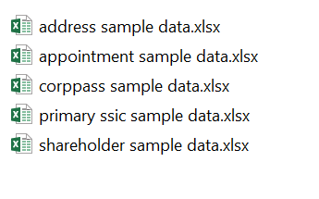
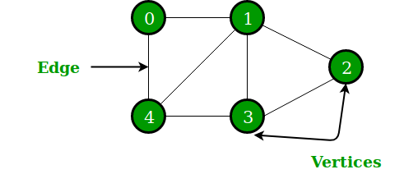
Graph Data Structures
Graph Structure to model Entity and Relationship
Entities are stored in separate Tables (Excel files)

Slide 5
Functions

Slide 6
Important Functions (Internal)
filter(g, filter_dic)
Inputs:
g: Graph for filtering [Graph]
filter_dic: dictionary for each category (Appointments, SSIC, etc) to be filtered [Dict of List]
E.g. {'Shareholder' : [], 'Appointment': [], 'Address': [], 'SSIC': [], 'CorpPass': []}
Output: Filtered Graph

Slide 7
All Functions (External)
G.depth(node, depth)
Inputs:
node: Node to start retrieving depth from [str]
depth: level of depth to be retrieved [int]
Output: Adjacency List [Dict of List]
G.shortestPath(node1, node2)
Inputs:
node1: start node [str]
node2: end node [str]
Output: List of paths [List]

Slide 8
Query Runtimes

Slide 9
Query Runtimes
 |  | Runtimes (30 rounds) | Num Nodes (Unique nodes) | Num Edges | Big O notation | Estimated Runtimes (for Actual Data)
Filter = Selected for each field | Depth = 1 | 0.006849647 | 7 | 7 | O(1) | 0.006849647
 | Depth = 2 | 0.007014481 | 17 | 19 | O(v) | 0.070144812
 | Depth = 3 | 0.007180754 | 21 | 25 | O(v^2) | 3.590377172
 | Shortest Path | 0.004720942 | ------------ | ------------ | O(v + e) | 2.36047109

